Slide 1



Energy Consumption Trend Analysis with Power BI

Slide 2

Learning Objectives
Data Import and Preparation in Power BI
Import energy datasets from multiple sources (Excel, CSV, databases, APIs).
Clean and transform raw energy data using Power Query Editor.
Create date and time hierarchies for temporal analysis (hourly, daily, monthly).
Build Dynamic Visualizations
Create line charts, area charts, and bar graphs to visualize energy trends over time.
Use slicers and filters to allow users to explore energy usage by building, time period, or equipment.
Implement custom visuals
GOAL

Slide 3
Tools and Technology used
Power BI Desktop
Main tool to build reports and dashboards.Allows you to connect, model, and visualize your data.
Power Query Editor
Cleans and prepares raw energy data.Helps filter, split, and transform columns easily.
Data Connectors (Excel, CSV, Database, API)
Bring in data from files, databases, or online sources.Supports formats like Excel, SQL Server, and web APIs.
Power BI Data Model
Links multiple tables using relationships.Supports fast and efficient analysis.
DAX (Data Analysis Expressions)
Used to create custom calculations like totals or trends.Supports time-based functions like YoY and MoM change.
Power BI Visuals
Show data using charts, graphs, and KPIs.Helps users understand trends and patterns quickly.
Power BI Service (Cloud)
Publishes and shares dashboards online.Allows secure access for teams and stakeholders

Slide 4
Methodology
ETI (Extract, Transform, Integrate) in Power BI:
1. Extract
Goal: To bring in data from various sources (e.g., energy usage data, weather data, building information) into Power BI.
Tools/Tech: Power BI Desktop’s Get Data function; common data sources include:
CSV/Excel files
Databases (SQL, Azure, etc.)
APIs (for real-time or external data, such as weather)
Cloud services (Azure, SharePoint, etc.)

Slide 5
2.Transform
Goal: To clean, reshape, and prepare the raw data for analysis.
Tools: Power Query Editor in Power BI, using the M Language for custom transformations:
Filter and Clean data (remove nulls, duplicates)
Parse/Format dates or time stamps (e.g., from "timestamp" to separate date and hour)
Normalize data (e.g., ensuring energy consumption is in consistent units like kWh)
3.Integrate
Goal: To combine data from different sources into a single, unified model.
Tools: Power BI's Data Model and DAX (Data Analysis Expressions):
Relationships: Link tables using primary/foreign keys (e.g., date table, building info, energy consumption data)
Lookup Tables: Help categorize data, like linking energy usage to building type or geographical region.

Slide 6
Problem Statement:
Organizations often face challenges in efficiently tracking and managing their energy consumption, leading to:
Higher energy costs in high demand periods or inefficiencies.
Lack of clear insights on energy usage trends over time.
Difficulty in forecasting future energy needs and optimizing consumption.
Prediction of raise in requirements of users.

Slide 7
Solution:
Using Power BI, we can create an Energy Consumption Trend Analysis Dashboard that:
Tracks energy consumption in real-time and over time (daily, monthly).
Identifies patterns such as peak energy usage and inefficiencies.
Provides interactive reports for decision-makers to make data-driven decisions.
Forecasts future energy needs to plan for cost reductions and sustainability goals.
IT WILL PROVIDE SOLUTION FOR ORGASATION BY
Optimize energy usage, lowering operational costs.
Make informed decisions to reduce energy waste.
Achieve sustainability goals by improving energy efficiency.

Slide 8
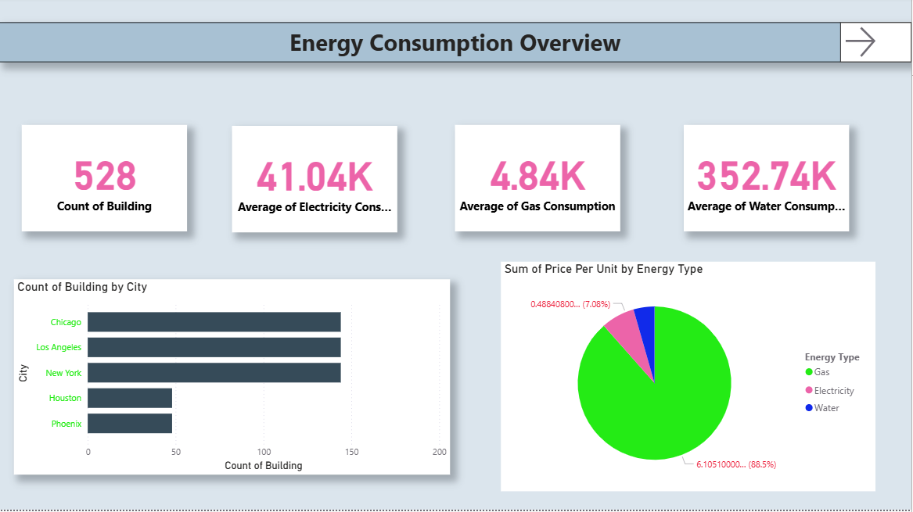
Screenshot of Output:

Slide 9
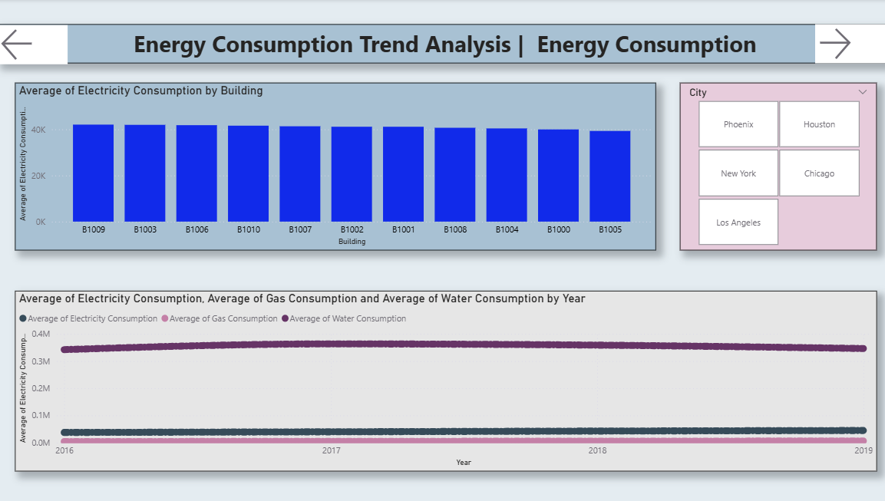

Slide 10
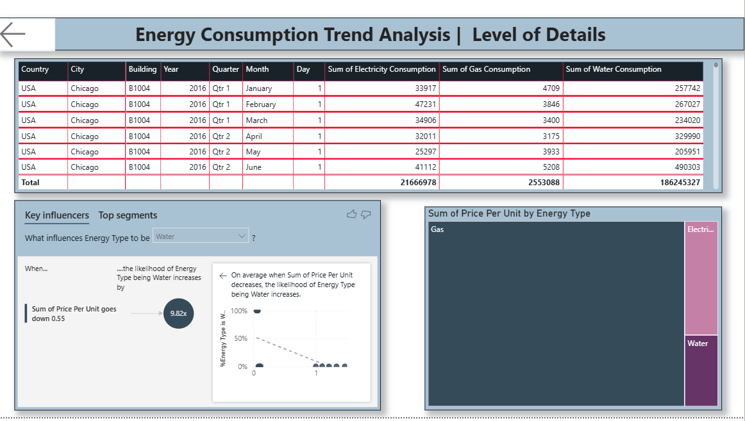

Slide 11
Conclusion:
Energy Consumption Trend Analysis project using Power BI aims to empower organizations to
Track and analyze energy consumption in real-time and over extended periods.
Identify inefficiencies and cost-saving opportunities by recognizing peak demand times and areas of high energy usage.
Optimize energy management and contribute to sustainability efforts by providing actionable insights to reduce energy waste.
GITHUB LINK : https://github.com/Peddamangari-Manoj/ENERGY-CONSUMPTION-USING-POWER-BI.git

